Slide 1

CSC3002F Networks Assignment 1
Group Members:
Kelvin Wei
Liam de Saldanha
Mark du Preez

Slide 2
Key Features & Rationale
GUI:
PyQt6 dependency – chosen for multi platform capability.
Show cases download progress from multiple seeders.
Allows converting from leecher to seeder.
Allows changing tracker information.
Allows changing of download location.
Additional
Script (autorun.sh) for quick running and termination of seeder and tracker.
Logging functionality for saving error messages for debugging purposes and monitoring of objects’ state. (Terminal tends to cut-off long outputs).
Tracker:
Keep track of seeders and maintain list of available files.
Timeout mechanism for removing inactive seeders.
UDP server
Seeder:
Pings Tracker to inform tracker that it is active.
Handles requests from leecher for file chunks.
Computes hashes and sends them with file chunk for file integrity verification.
Leecher:
Gets seeder and file list from tracker.
Can download in parallel from multiple seeders.
Can ask seeder to resend file chunks if file chunk is damaged.

Slide 3
Protocol Specification
Message Types:
Commands
add_seeder
\n (tcp_address)
ping_tracker
\n (tcp_address)
request_seeder_list
request_file_list
request_connection
request_file_chunk
\n [file_name, num_chunks, send_after]

Slide 4
Protocol Specification
Data Transfer
upload_file_list
\n [file_name1, file_name2, …, file_name_n]
Control
connected
away
exit_connection
error
success
acknowledgement
error_not_acknol

Slide 5
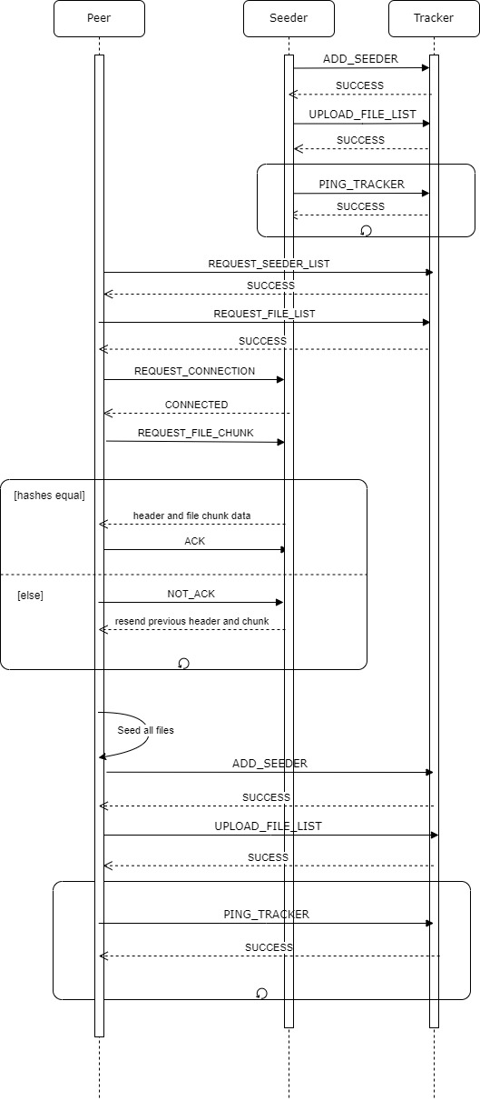
Communication Sequence

Slide 6

Tracker Startup

Slide 7
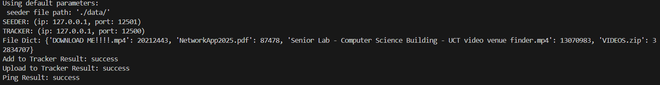
Seeder Startup

Slide 8

Seeder Pinging Tracker

Slide 9
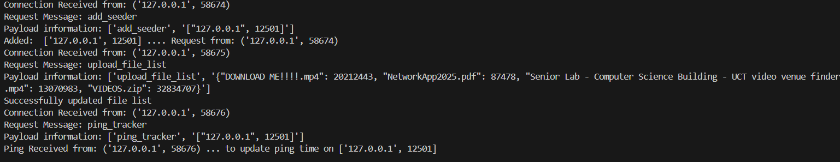
Tracker Receives Seeder

Slide 10
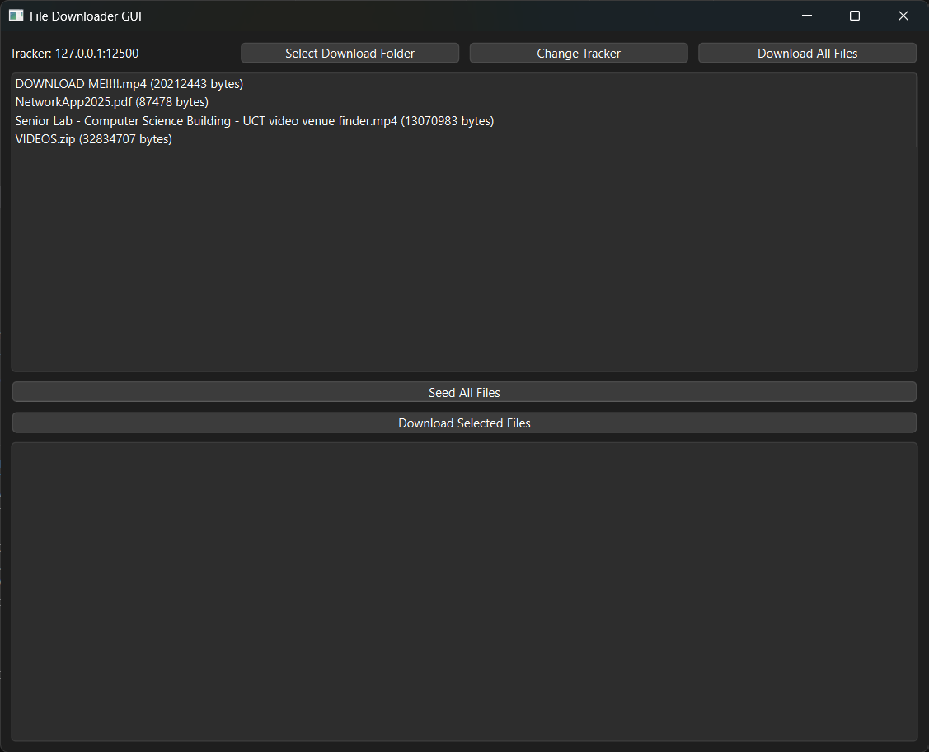
Leecher Startup

Slide 11
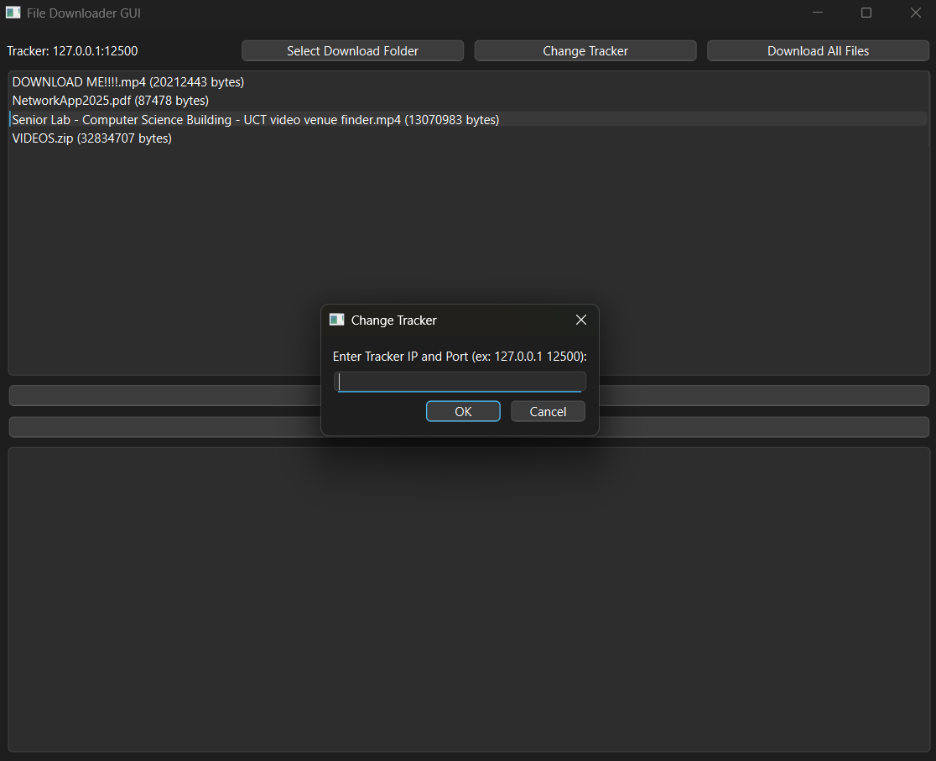
Changing Tracker

Slide 12
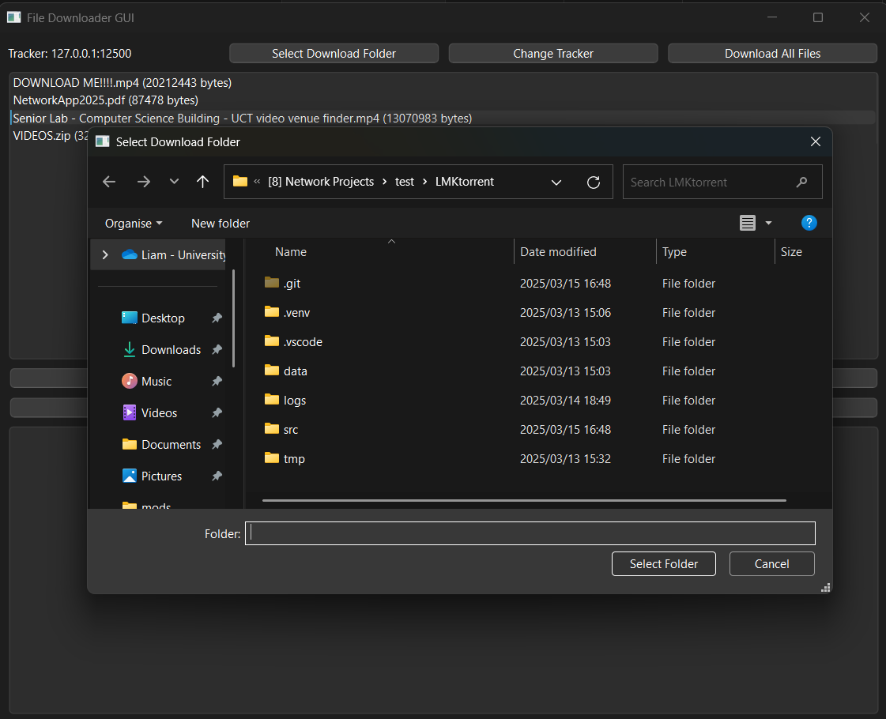
Selecting a Download Folder

Slide 13
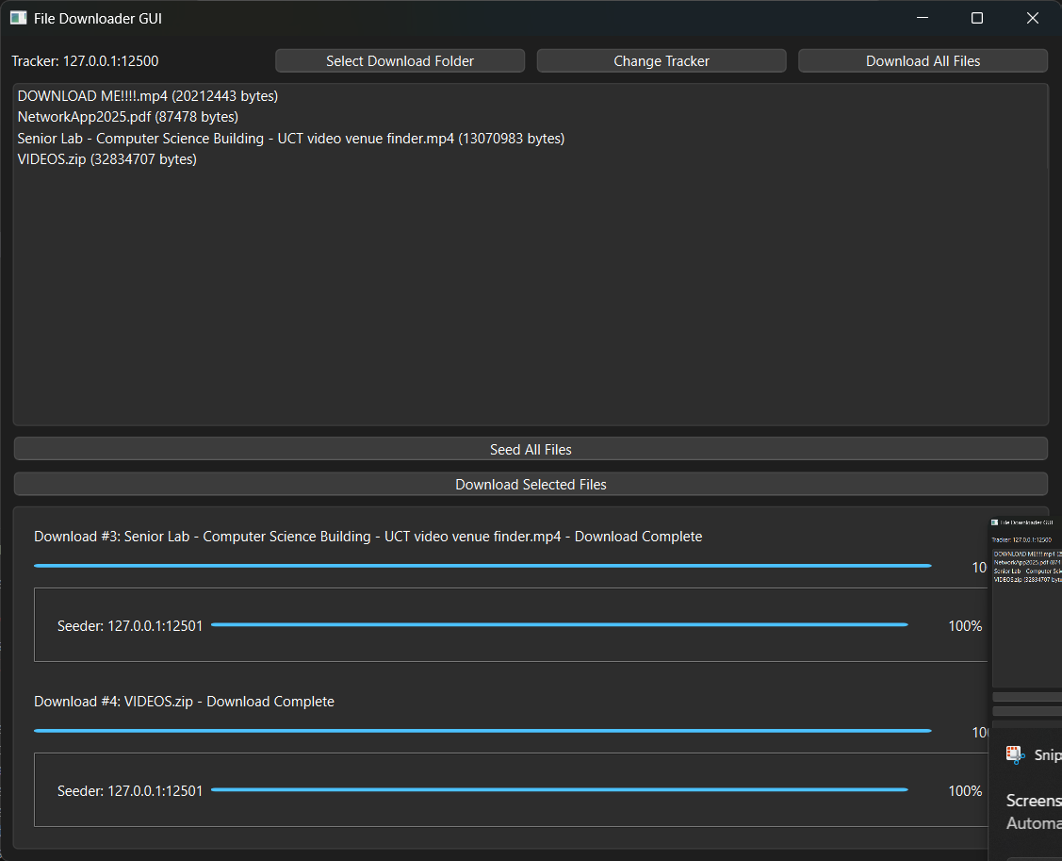
Downloading Files

Slide 14
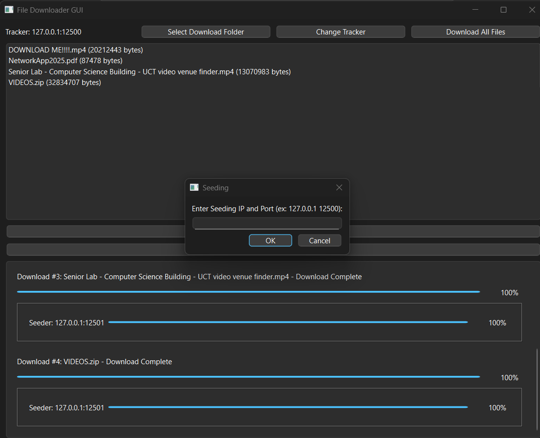
Transitioning Into a Seeder (optional)

Slide 15
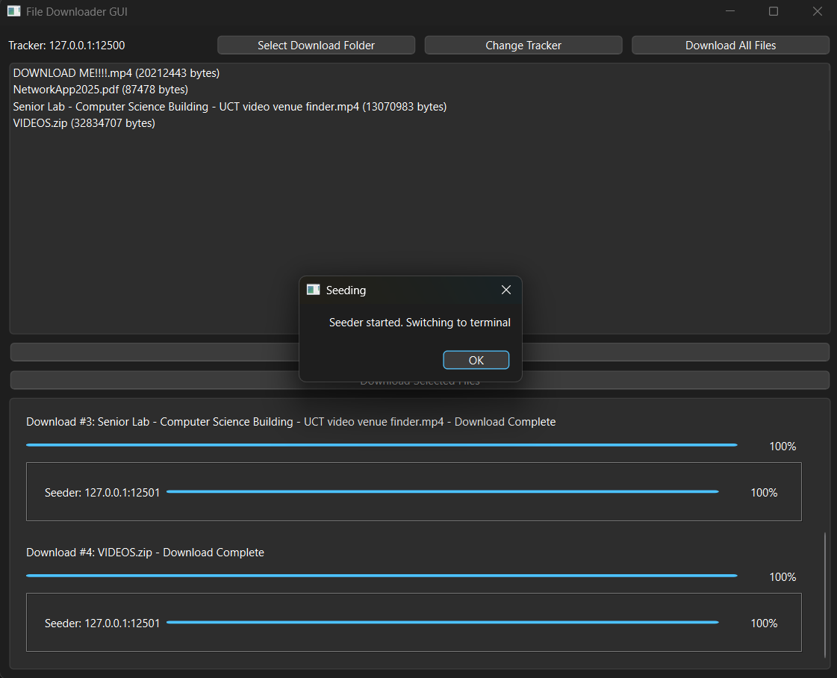

Slide 17
Questions?

